Slide 1
Optical Storage Media

Slide 2
Optical Storage Media
Current magnetic data storage carriers take the form of floppy disks or hard disks said are used as secondary storage media.
Since audio and video, either in compressed or compressed form, require higher storage capacity than other media, the storage cost for such continuous media data using traditional storage carriers is essentially higher.
Optical storage media offer a higher storage density at a lower cost.
The Audio Compact Disk, the successor to Long Play Disks (LPs), is a commercially successful product in the entertainment industry.

Slide 3
Optical Storage Media
The computer industry has profited from this development, especially when audio and video should be stored digitally in the computer
This technology has been the main catalyst for the whole development of multimedia in computing because it is used in multimedia external devices.
For example, external devices such as video recorders and DAT recorders (Digital Audio Tape) can be used for multimedia systems.
The actual integration into the system is difficult, but not impossible.

Slide 4
Basic Technology
In principle, optical storage media use the intensity of reflected laser light as an information source.
A laser beam of approximately 780 nm(nano meter) wave length can be focused at approximately 1 µm.
In a polycarbonate substrate layer we encounter holes, corresponding to the coded data, which are called pits.
The areas between these pits are called lands

Slide 5
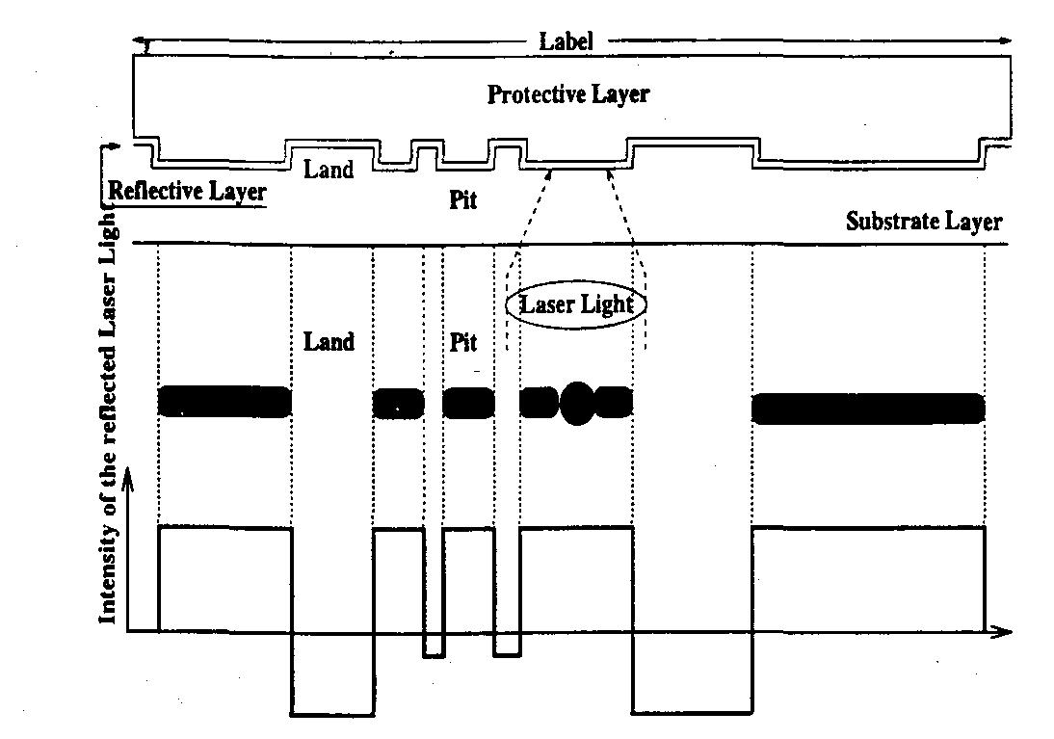
Basic Technology

Slide 6
Basic Technology
The substrate layer is covered with a thin reflective layer.
The laser beam is focused on the reflective layer from the substrate layer.
Therefore, the reflected beam has a strong intensity at the lands. The pits have a depth of 0.12 µm (from the substrate surface).
The laser beam is lightly scattered at the pits, meaning it is reflected with a weak intensity.
Hence, according to Figure 7.1, a compact disk consists of:
The label , protective layer, reflective layer and substrate layer

Slide 7
Basic Technology
The track is a spiral.
In the case of a CD, the distance between the tracks is 1.6 im(µm).
The track width of each pit is 0.6 µm.
The pits themselves have different lengths.
Using these measurements, the main advantage of the optical disk in comparison to magnetic disks is that on the former 1.66 data bits per µm can be stored.
This results in a data density of 1,000,000 bits per mm2, which implies 16,000 tracks per inch. In comparison, a floppy disk has 96 tracks per inch.

Slide 8
Video Disks and Other WORMs
The video disk, in the form of Laser Vision, serves as the output of motion pictures and audio.
The data are stored in an analog-coded format on the disk; the reproduced data meet the highest quality requirements.
The Laser Vision disk has a diameter of approximately 30 cm and stores approximately 2.6 Gigabytes.
Due to the similarities to LP records for audio information, the video disk was originally called the Video Long Play disk.

Slide 9
Video Disks and Other WORMs
Since the video disk was designed as Read Only Memory (ROM), many different write-once optical storage systems have come out, known as the Write Once Read Many (WORM) disk.
An example is the Interactive Video Disk. This disk is played at a Constant Angular Velocity (CA V).
On each side, 36 minutes of audio and video at a rate of 30 frames per second can be stored and retrieved.
One can also store around 54,000 studio quality images per side.

Slide 10
Video Disks and Other WORMs
Write-once storage media have a capacity between 600 MBytes and 8 Gigabytes.
The diameter of the disks is between 3.5 and 14 inches.
The main advantage of a WORM disk, compared to other mass storage media, is the ability to store large amounts of data which may not be changed later, i.e., an archive which is secure.
To increase capacity, juke-boxes are available, which allow the stocking of several disks and lead to capacities of over 20 Gigabytes.

Slide 11
Compact Disk Digital Audio
The CD has a diameter of 12 cm; the disk is played at a Constant Linear Velocity (CLV).
Therefore, the number of rotations per time unit depends on the particular radius of the accessed data.
The spiral-shaped CD track consists of approximately 20,000 windings.
In comparison, an LP(long play) disk has only approximately 850 windings.
The length of the pits is always a multiple of 0.3 µm. The transition from pit to land and from land to pit corresponds to the coding of a 1 in the data stream.

Slide 12
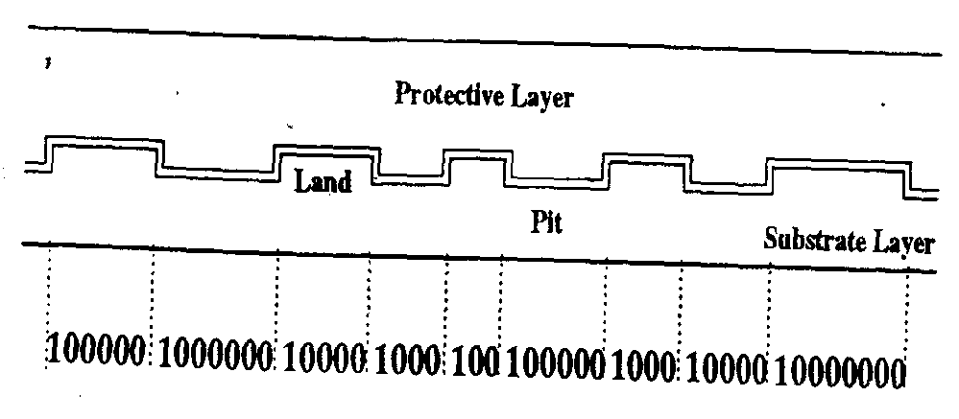
Compact Disk Digital Audio

Slide 13
Audio Data Rate
The audio data rate can be easily derived from the given sample frequency of 44.1 kHz and the 16-bit linear quantization.
The stereo-audio signal obeys the pulse-code modulation rules and 172.3 kbytes/sec audio data rate is derived.

Slide 14
Capacity
A CD-DA play time is at least 74 minutes. With this value, the capacity of a CD-DA can be easily determined.
Capacity for pure audio data will be 747Mbytes

Slide 15
Eight-to-Fourteen Modulation
Each change from pit to land and from land to pit corresponds to the coding of a 1 which is sent across a communication channel as the channel bit.
Pits and lands may not follow too closely one after another on a CD-DA since the resolution of the laser is not sufficient to read such direct pit-land-pit-land-pit sequences (i.e., 11111 sequences) correctly.
Therefore, an agreement was negotiated that at least two lands and two pits always occur consecutively in a sequence. Hence, between two 1s there always exist at least two Os.

Slide 16
Eight-to-Fourteen Modulation
On the other hand, pit or land sequences are not allowed to be too long; they must keep a maximal distance.
Otherwise, no phase-correct synchronization signal (clock) can be derived.
Hence, the maximal length of the pits and lands is limited.
At most, ten Os (as the channel bits) can follow one after another. .

Slide 17
Eight-to-Fourteen Modulation
For these reasons, the bits written on a CD-DA, in the form of pits and lands, do not directly correspond to the actual information
Eight-to- Fourteen Modulation is applied
Using this transformation, the regularity of the minimal and maximal distances is met.

Slide 18
Error Handling
The goal of error handling on a CD-DA is the detection and correction of typical error patterns
A typical error, a consequence of a scratch and/or pollution, can be characterized as a burst error.
On the first level, a two-stage error correction is implemented according to the Reed- Solomon algorithm: for every 24 audio bytes, at the first stage, individual byte errors are recognized and corrected; at the second stage, double byte errors are recognized and corrected; also, other fault bytes in the sequence can be recognized, but they cannot be corrected using this approach.

Slide 19
Compact Disk Read Only Memory (CD-ROM)
Designed as the storage format for general computer data – in addition to uncompressed audio data
Planned to be basis for storage of other media (e.g. video)
Specified in the Yellow Book by N. V. Phillips and The Sony Corporation
CDROM tracks are divided into audio (corresponding to the CD-DA) and data tracks
One track may either contain audio only or data only
Can contain both types of track, tracks with audio and other tracks with data. Mixed form, the data tracks are usually located at the beginning of the CD-ROM followed by the audio tracks- called Mixed Mode Disk

Slide 20
Blocks
CD-DA has an error rate of less than 10⁻⁸ and allows random access to individual tracks and index points.
Use of CD-ROM with its general purpose computer data requires much better error correction and random access to a data unit with a higher resolution than the track
This data unit is called a block, meaning physical block
A CD-ROM block consists of 2352 bytes; out of 2352 bytes of a block, 2048 or 2336 bytes depending on whether computer data or audio data are stored on CD-ROM) can be used for user data.
The remaining bytes are used for the identification of random access and for error correction

Slide 21
Blocks Contd.
75 blocks / sec are played back, each containing 32 frames.
Each frame is 73.5 bytes (588 bits)
Block = 1411200 bits/s X 1/75 s X 1/(8 bits/byte) = 2352 bytes

Slide 22
CD-ROM Modes
CD-ROM Mode 1 block layout
Synchronization – 12 bytes – for the detection of the block beginning
Header – 4 bytes – carries unambiguous specification of the block. 1st byte stores minute, 2nd stores seconds, 3rd contains the block number, and 4th byte includes the mode specification
Used Data – 2048 bytes
Error Detection – 4 bytes
8 bytes – unused
Error correction – 276 bytes. Hence an error rate of 10⁻¹² can be achieved
Sync 12 | Header 4 | User Data 2048 | EDC 4 | Blanks 8 | ECC 276

Slide 23
CD-ROM Modes Contd.
CD-ROM contains 333000 blocks to be played in 74 mins
Capacity (CD-ROM mode 1) =
= 333000 blocks X 2048 bytes /block = 681,984,000 bytes
= 681,984,000 X 1/(1024 bytes /Kbyte) X 1/(1024 Kbyte/ Mbyte)
= 660 Mbytes
Data Rate (CD-ROM mode 1)
= 2048 bytes/block X 75 blocks/s
= 153.6 Kbytes /s (150 Kbytes/s approx.)

Slide 24
CD-ROM Mode 2 block layout
Sync 12 | Header 4 | User Data 2336
Capacity (CD-ROM mode 2) =
= 333000 blocks X 2336 bytes /block
= 777,888,000 bytes
= Data Rate (CD-ROM mode 2)
= 2336 bytes/block X 75 blocks/s
= 175.2 Kbytes /s approx.

Slide 25
CD-ROM Extended Architecture (CD-ROM/XA)
Standard established by N.V. Phillips, the Sony and the Microsoft Corporations and is based on the CD-ROM specification
CD-ROM/XA Form 1 block layout
CD-ROM/XA Form 2 block layout
Sub-header – 8 bytes – describes the particular block, makes it possible to interleave different media
Sync 12 | Header 4 | Sub-Header 8 | User Data 2048 | EDC 4 | ECC 276
Sync 12 | Header 4 | Sub-header 8 | User Data 2324 | EDC 4

Slide 26
Compact Disk Write Once (CD-WO)
Allows user to write once to CD and afterwards to read it many times
Principle of CD-WO
An absorption layer exists between the substrate layer and the reflection layer
Protective Layer
Reflection Layer
Absorption Layer
Substrate Layer
Pit/Land
Pit/Land

Slide 27
CD-WO Contd.
It can be irreversibly modified through strong thermal influence, which changes the reflection properties of the laser beams
In its original state, a CD-WO player recognizes a track consisting of lands
The absorption layer in the pre-grooved track is heated to above 250⁰C with a laser 3 ~ 4 times the intensity of the reading player, changing the absorption layer such that the reflection of the laser light now corresponds to a pit.

Slide 28
Compact Disk Magneto Optical (CD-MO)
Has a high storage capacity and allows to write multiple times to CD
Principle of the Magneto-Optical Method
Based on the polarization of the magnetic field where the polarization is caused by heat
Write: the block is heated to above 150⁰ C, simultaneously a magnetic field approximately 10 times the strength of the earth’s magnetic field is created.
The individual dipoles in the material are then polarized according to this magnetic field, where a pit corresponds to a low value of the magnetic field and a land bit is coded through a high value
Read: the polarization of the light changes corresponding to the existing magnetization after the CD is irradiated with a laser beam
Delete: A constant magnetic field is created in the area of a block and the sector is simultaneously heated

Slide 29
DVD - digital versatile disc digital video disc
a type of optical disk technology similar to the CD-ROM
holds a minimum of 4.7GBof data, enough for a full-length movie
commonly used as a medium for digital representation of movies and other multimedia presentations that combine sound with graphics.
The DVD specification supports disks with capacities of from 4.7GB to 17GB and access rates of 600KBps to 1.3 MBps.
One of the best features of DVD drives is that they are backward-compatible with CD-ROMs, meaning they can play old CD-ROMs, CD-I disks, and video CDs, as well as new DVD-ROMs. Newer DVD players can also read CD-R disks.
DVD uses MPEG-2 to compress videodata.

Slide 30
DVD Formats
DVD+R, DVD+RW, DVD-RAM, DVD-R, DVD-RW, DVD-ROM
DVD: Short for digital versatile disc or digital video disc, a type of optical disk technology similar to the CD-ROM. DVD-Video: A video format for displaying full-length digital movies. DVD-ROM: A type of read-only compact disc that can hold a minimum of 4.7GB (gigabytes), enough for a full-length movie. Divx: Short for Digital video express, a new DVD-ROM format promoted by several large Hollywood companies. With Divx, a movie (or other data) loaded onto a DVD-ROM is playable only during a specific time frame, typically two days.

Slide 31
Why Are There So Many DVD Formats?
The crucial difference among the standards is based on which standards each manufacturer adheres to.
Plus or Minus - What's The Difference?
The different variations on the term DVD (e.g. +R, -R, -ROM, and so on) describe the way data is stored on or written to the disc itself. These are called physical formats.
Successors to DVD
Several technologies are seen as successors to the standard DVD. These include HD-DVD, Blu-ray, AOD and HVD (Holographic Versatile Disc).

Slide 32
USB Flash Drive
compact file storage devices to save information externally.
are about the size of a disposable lighter and can be conveniently worn around the neck or attached to the keychain.
The end is inserted into the USB port on the computer, once attached to the computer, they operate in much the same way as floppy drives, but have higher capacities ranging from few MB up to GB.
Also Known As: USB memory stick, jump drive

Slide 33
Secure Digital (SD) Card
a nonvolatile memory card used extensively in portable devices, such as mobile phones, digital cameras,GPS navigation devices, handheld consoles, and tablet computers
standard was introduced in August 1999 as an improvement over MultiMediaCards (MMC). maintained by the SD Association (SDA).

Slide 34
Secure Digital format
includes four card families available in three different form factors.
The four families are the original Standard-Capacity (SDSC), the High-Capacity (SDHC), the eXtended-Capacity (SDXC), and the SDIO, which combines input/output functions with data storage.
The three form factors are the original size, the mini size, and the micro size.
Electrically passive adapters allow a smaller card to fit and function in a device built for a larger card.
There are many combinations of form factors and device families, the prevailing formats are full- or micro-size SDHC and full or micro SDXC.
The SDA uses several trademarked logos to enforce compliance with its specifications and assure users of compatibility.

